Slide 1

Predicting Weather Patterns in Europe
Machine Learning Analysis - ClimateWins
Kyle Stanford
Updated: November 2nd, 2024

Slide 2





1. Project Objectives (and thought experiment overview)
2. Machine Learning Algorithms Overview
Agenda
3. Thought Experiments
4. Social & Ethical Considerations
5. Summary & Recommendations

Slide 3
Identify weather patterns outside the regional norm in Europe
Determine if unusual weather patterns are increasing
1
2
Project Objectives
Determine the safest places for people to live in Europe over the next 25-50 years
Generate possibilities for future weather conditions over the next 25-50 years based on current trends
4
3

Slide 4




Thought Experiments
1. Unusual Weather Pattern Detection
2. Forecasting Future Weather Scenarios
3. Identifying Safe Regions
Use supervised and unsupervised models to identify anomalies and assess trends of unusual patterns.
Objective 1 and 2
Generate plausible future climate conditions across Europe using time-series models.
Objective 3
Combine forecasted weather conditions with classification models to identify safe locations.
Objective 4

Slide 5
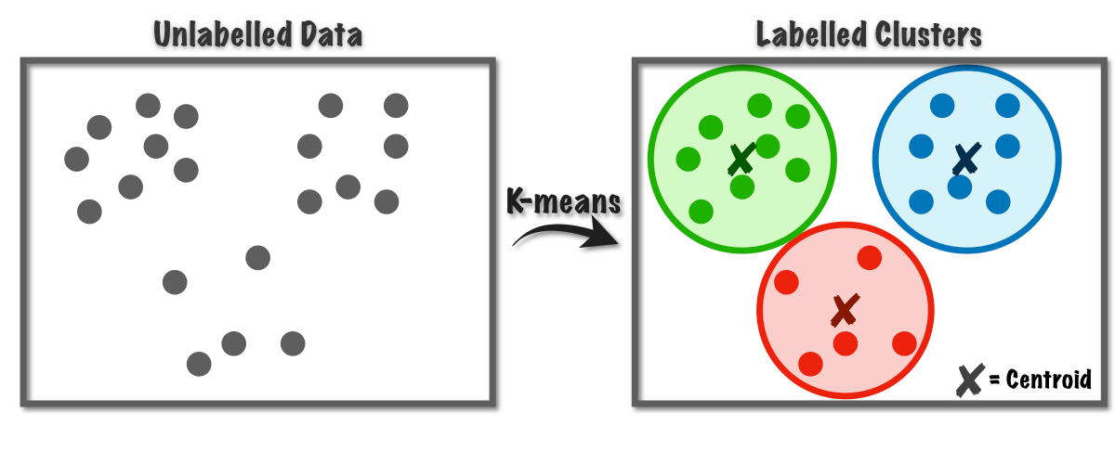
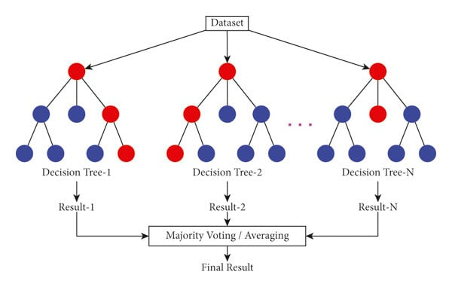
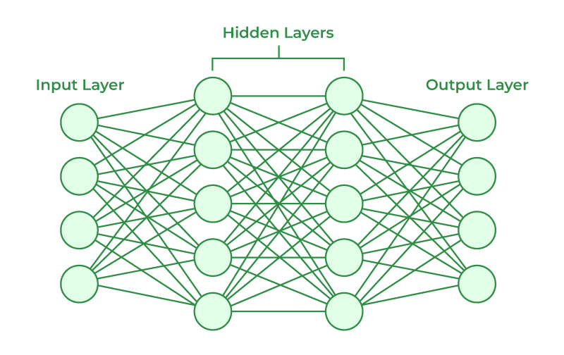
Overview: Machine Learning Algorithms
Deep Learning (LSTM / RNNs)
K-Means Clustering
Random Forests
How it works:
Groups similar data points into clusters.
Applications:
Create groupings in weather data based on similar patterns and measurement values. Theoretically, anomalies should also stand out.
How it works:
Combines results from multiple decision trees to make more accurate predictions.
Applications:
Predict and categorise weather patterns across Europe (and the globe).
Also provides insights into the most important features in its predictions.
How it works:
Interacts with large datasets to extract important and complex patterns.
Applications:
LSTM models can capture long-term dependencies in sequential data, making it ideal for forecasting long-term weather patterns.
Notes:
Acknowledge these are the 3 main machine learning / deep learning models featured in the upcoming proposals AND that other models like GANS and hierarchical clustering is being considered as supplementary or alternative models to achieve ClimateWins objectives.

Slide 6
1. Unusual Weather Pattern Detection
Idea
Identify and investigate weather patterns that are outside of regional norms to determine if unusual weather is becoming more frequent and/or intense.
Approach
K-Means Clustering: Use to identify and label similar data (similar weather patterns). Anomalies would be far from centroids or form very small clusters. May also be able to assign categories based on clusters or a point’s distance from its centroid (‘mild’, ‘severe’, ‘dangerous’).
Random Forests: Use feature importances to assess which features most significantly contribute to identifying anomalies.
Group anomalies and analyse their occurrences overtime to detect shifting weather patterns.
Required Data
Historical Weather Data (from various regions across Europe for the last 50 to 100 years)

Slide 7
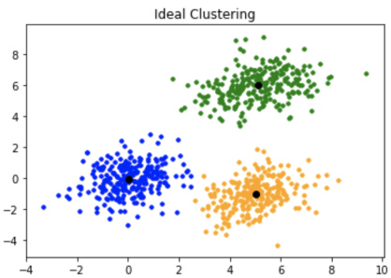
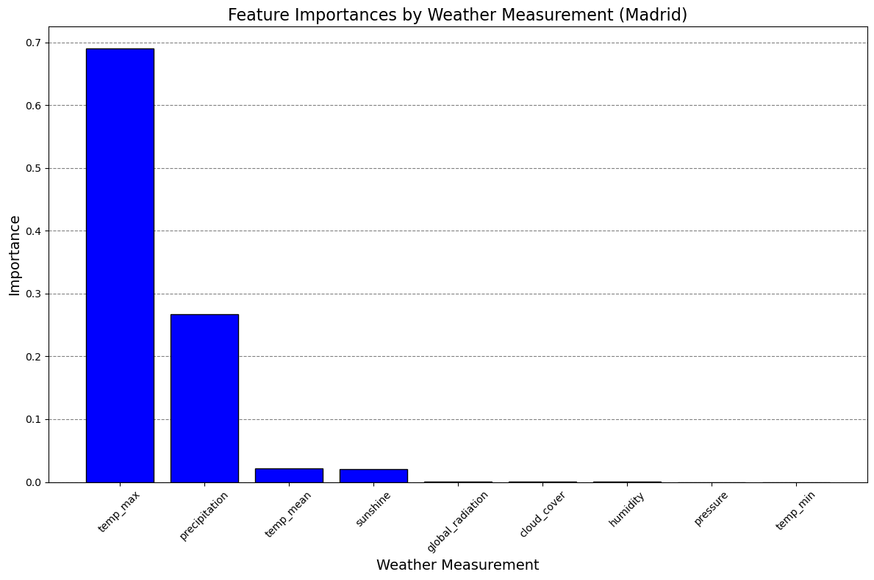
1. Put into Practice:
Example
Anomalies
K-means clustering would be used on the historical weather to essentially create labels pertaining to different weather conditions.
Extreme weather could also be better identified by assigning labels based on the distance a data point is away from its centroid.
Plot of Feature Importances from Random Forest Model trained to recognize ‘pleasant’ and ‘unpleasant’ weather data.
Random Forest Accuracy: 100% (after optimization)

Slide 8
2. Forecasting Future Weather Scenarios
Idea
Generate plausible future weather scenarios across Europe and analyse the forecast for extreme changes in weather measurements of interest.
Approach
LSTM Network: train the model on historical weather data and climate projections to allow the model to forecast weather trends for the next 25 to 50 years.
Random Forests: use to categorise weather severity and assess which features in the data contribute most to categorisation.
GANs: Could supplement LSTM network forecasting, providing diverse weather scenarios using satellite images and historical data.
Required Data
Historical Weather Data (from various regions across Europe for the last 50 to 100 years)
Climate Data and Projections (for factors like CO₂ emissions and population growth) (World Bank)

Slide 9
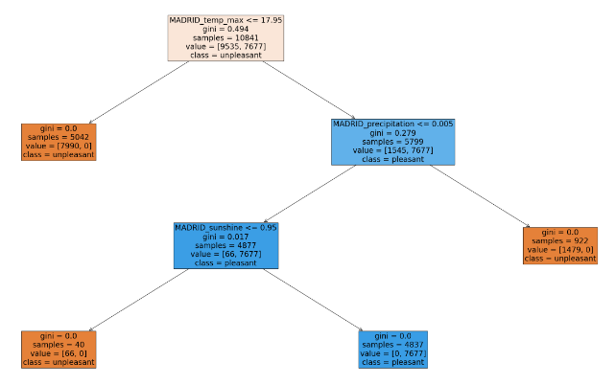
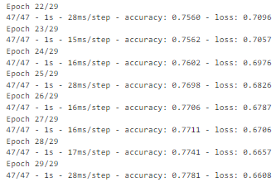
2. Put into Practice:
The above snippet came from an optimised LSTM model that was trained to recognized pleasant and unpleasant weather.
Its training accuracy was 77.81% but struggled with testing data (more work is needed).
Example of decision tree from Random Forest showing how it makes its decisions when categorising the weather in Madrid.
One tree looks overly simply, but many decision trees come together to make for a more accurate model in a Random Forest.

Slide 10
3. Identifying Safe Regions
Idea
Using classification models, identify and group the safest European regions based on a combination of safety metrics and forecasted weather data.
Approach
Defining Safety: This is somewhat interpretable, but an elementary guess would be several scores based on:
K-means or Hierarchical Clustering: Used to compare regions based on their safety scores. This could be done before and after integrating forecasted weather data to observe changes to region safety.
Frequency/severity of natural disasters
Resilience of local infrastructure
Erratic weather patterns (documented and forecasted)
Required Data
Historical Weather Data for Europe
Natural Disaster Incidents Data
Infrastructure Resilience Data

Slide 11
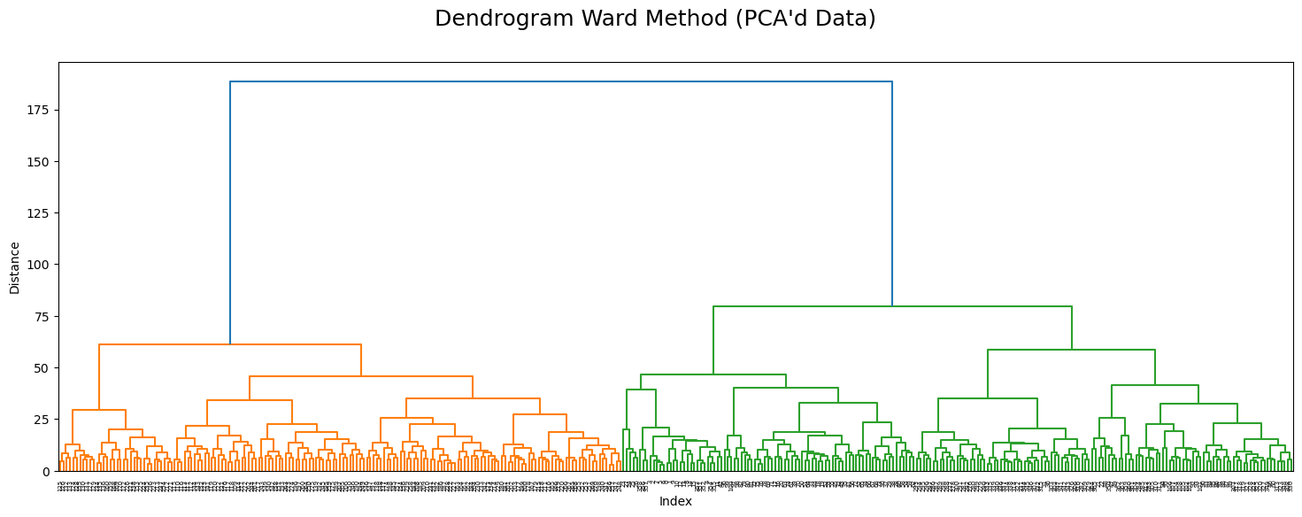
3. Put into Practice:
Dendrogram Ward Method using European weather data after reducing data dimensions by performing Principal Component Analysis.
This method shows promise in dividing data into distinct clusters based on similarity, indicating that key patterns and features would be prominent and interpretable.

Slide 12



Social and Ethical Considerations
Transparency
Accountability
Equity
Clear communication for public trust.
Make information regarding models, rationale for models used, and limitations available.
Models may influence environmental and government initiatives.
Models must have regular oversight and be subject to scrutiny.
ClimateWins must be prepared to take accountability for errors.
Models should account for all communities.
Ensure all communities benefit from models’ insights.

Slide 13

Summary
Relatively simple models and therefore easiest implementation & interpretation.
Historical weather data readily available.
Capacity for integration with other models (CNN) and real-time data sources (e.g., satellite images).
K-Means Clustering assumes spherical, equally-sized clusters, which may not fit true structure of historical data.
Somewhat arbitrary act of pre-defining the number of clusters (potentially leading to inconsistent results).
Scenario 1: Unusual Weather Pattern Detection
Allows for greater understanding of future climate risks.
LSTM model is known to handle time-series data effectively for forecasting.
GANs allow for multiple scenarios to be explored.
LSTM models can be computationally expensive.
Model complexity necessitates expertise to ensure correct model infrastructure, tuning, and maintenance.
Scenario 2: Forecasting Future Weather Scenarios
Can be applied to historical weather data to assess safe regions now and in the future (pending results of previous scenarios).
Analysis captures multiple safety-factors.
Identification of future safe regions is dependent on forecasted data from scenario 2.
Potential difficulty deciding where to cut dendrograms to form clusters (affecting interpretability).
Hierarchical clustering is sensitive to noise/outliers.
Scenario 3: Identifying Safe Regions

Slide 14
Final Recommendations
1) Immediately develop models to detect unusual weather patterns.
This is the most achievable project which will also yield short-term results.
Scenario 1: Unusual Weather Pattern Detection
2) Start allocating resources to develop a LSTM model for long-term forecasting.
Comparing results of this model with Scenario 1 can help address model inconsistencies and strengthen short- to mid-term results
Scenario 2: Forecasting Future Weather Scenarios
3) Once Scenario 1 and 2 gain momentum, begin working on Scenario 3.
This will require careful stakeholder management and staff dedicated to policy research to ensure social inequities or tensions are not worsened by the identification of “unsafe” regions.
Scenario 3: Identifying Safe Regions
Notes:
Emphasise the 3 scenarios essentially follow on from one another and shouldn’t be viewed as separable projects. The implementation of scenario 2 and 3 are likely to be affected by the results of the preceding scenarios.

Slide 15




Thank you
Have Any Questions?

